Slide 1
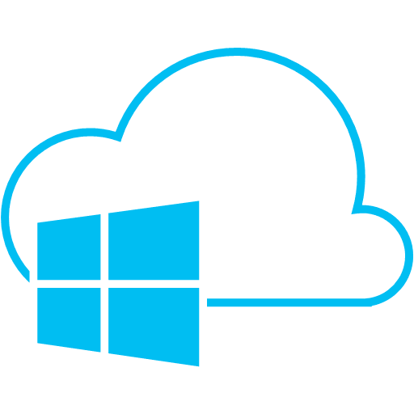
Cloud Computing With Microsoft Azure
Presentation by Aaron Hinton
UMSL – Information Systems Programming Club
March 18th 2015

Slide 2
Microsoft Azure Presentation Discussion Topics
What is cloud computing?
What is Azure?
Why use Azure?
Getting started
Next steps

Slide 3
Key Cloud Computing Concepts
The cloud is simply a pool of hardware, software, and resources that subscribers have access to.
Available from anywhere and at any time
Users are not responsible for maintaining the cloud’s systems
Typically pay-as-you-go (hourly / daily / monthly)
You only pay for what you use

Slide 4
Cloud Service Types
IaaS – Infrastructure as a service
Refers to the “leasing” of computer hardware / virtual machines from a provider
PaaS – Platform as a Service
Provides a higher level of abstraction than IaaS
Provides developers with the access to the software and resources to store data and run their applications
SaaS – Software as a service
Early development in this realm is credited to Marc Benioff, The founder of the CRM tool Salesforce
Allows users to utilize software without having to maintain client side software and resources

Slide 5
Cloud Services Available
Storage
Data warehousing, disaster recovery, geo-redundancy
Computing Processing
Compute time for processor intensive operations
Graphics, Video, Cryptography, Business Intelligence, etc.
Software Services
Software hosting , Software Deployment , Application Services
Databases
SQL, NoSQL, MySQL
Servers
Virtual Machines

Slide 6
The Benefits of Cloud Computing
Flexible
Infrastructure can be added and removed as needed
Easy to scale with business levels / size
Lower Maintenance costs
No equipment to maintain / upgrade
No software to maintain / upgrade
Efficient
Electrical resources are not wasted on idle computers and equipment
No Downtime
Services can be started almost instantaneously.
Geo-redundancy and disaster recovery is easy to implement.

Slide 7
Popular Cloud Computing Platforms
Amazon Web Services (AWS) – 27%
Started in 2006
First major “Cloud” service provider
Microsoft Azure - 11%
Started in 2008
Quickly became a major player in Cloud computing
Leverages Microsoft’s extensive coverage of development and enterprise solutions
Google Cloud – 7.5%
Began in 2008. However, didn’t become full-service until 2014

Slide 8
Azure Services
Comprehensive feature set
Virtual Machines
Cloud Services
RemoteApp (Application Virtualization)
Websites
Mobile Services
Databases
Storage
Data Analytics
Virtual Network Modeling
Site Recovery / Backup
Active Directory Integration

Slide 9
Supported Platforms In Azure
Supported languages
.NET
VB
Python
Java
PHP
Supported Frameworks
.NET MVC
Node.js
Django
Wordpress
Drupal
And more…

Slide 10
Enterprise Benefits
Complicated systems can be integrated into a common platform
Easier to setup
Lower latency
Backup and recovery
Easier to implement extensive geo-redundancy and lowers downtime risk
Hybrid architecture is possible
Services are purchased to supplement existing resources as needed

Slide 11
Making Use of Azure as a Student
Deploy personal websites
Resume website
Experiment with integrating various computer technologies
Web servers
Databases
Tryout new technologies without setting up servers
Wordpress, Drupal
NoSQL Databases
Django, Node.js
Class Projects
Presentation
IS Design Class
Build out virtual networks and infrastructure to practice in-class concepts

Slide 12
Demonstration
Website startup from Azure portal
Website deployment from Visual Studio
Demo a web application that utilizes
SQL Database
Azure Cloud Storage
Azure Web Services
SendGrid Email Services
Twilio Text Messaging

Slide 13

Further Information
Books
Zen of Cloud: Learning Cloud Computing by Examples on Microsoft Azure
Online Resources
Microsoft Azure: http://azure.microsoft.com
Microsoft Virtual Academy
Fundamentals
Fundamentals : Websites
Fundamentals : Storage

Slide 14
Questions & Answer

Slide 15
Works Cited
Microsoft. (n.d.). Microsoft Azure: Cloud computing platform and services. Retrieved March 17, 2015, from Microsoft Azure: http://azure.microsoft.com/en-us/
Microsoft. (n.d.). Microsoft Virtual Academy. Retrieved March 17, 2015, from Microsoft Virtual Academy: http://www.microsoftvirtualacademy.com/
Seitz, P. (2014, November 18). Amazon Web Services Rains On Other Cloud Vendors. Retrieved March 17, 2015, from Investors.com: http://news.investors.com/technology/111814-726996-amzn-dominates-cloud-computing-but-msft-growing.htm

